Slide 1
Multithreading Models in Operating system

Slide 2
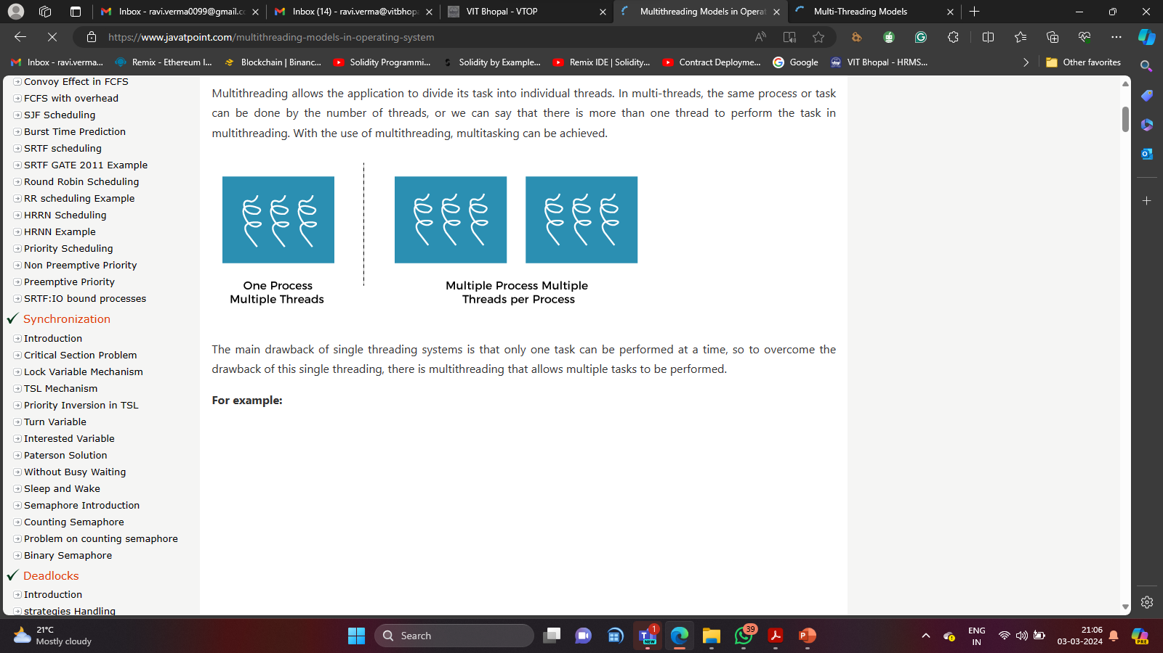
Multithreading Model:
Multithreading allows the application to divide its task into individual threads. In multi-threads, the same process or task can be done by the number of threads, or we can say that there is more than one thread to perform the task in multithreading. With the use of multithreading, multitasking can be achieved.

Slide 3
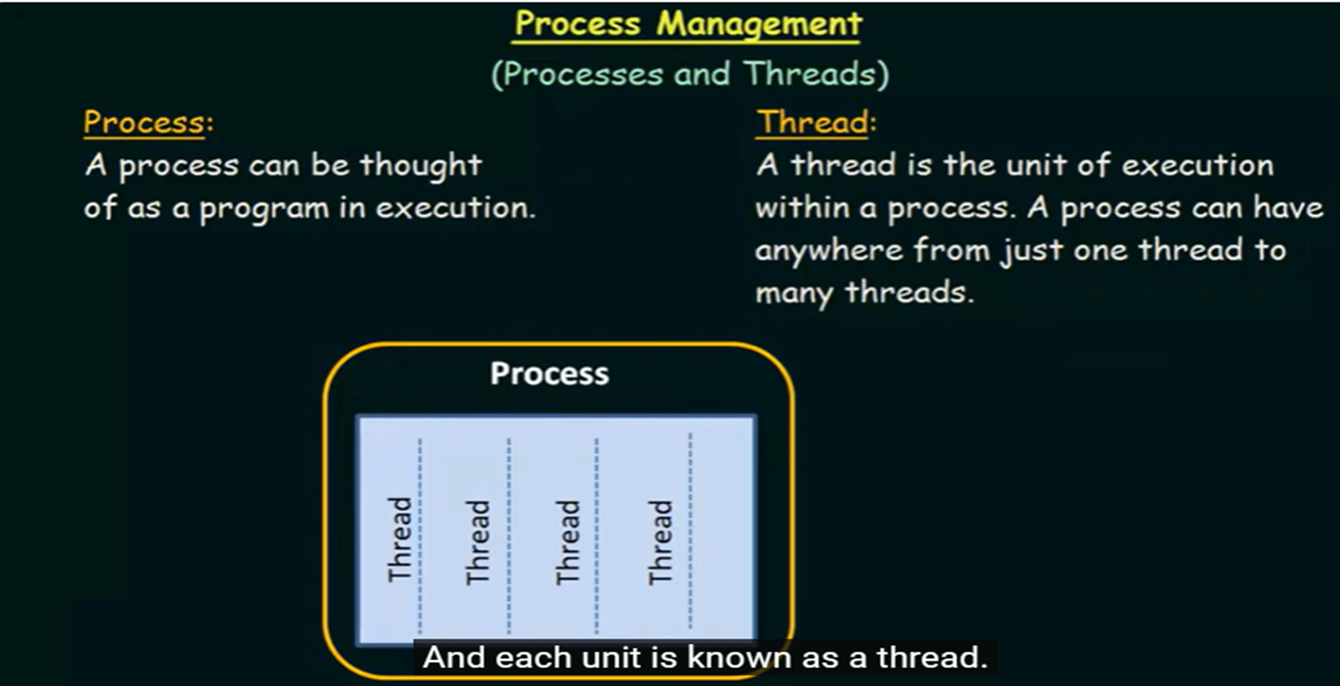

Slide 4
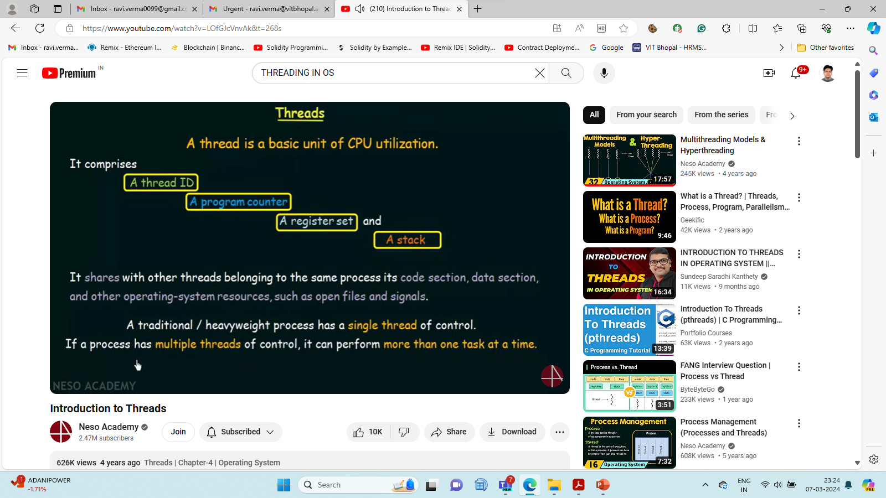

Slide 5
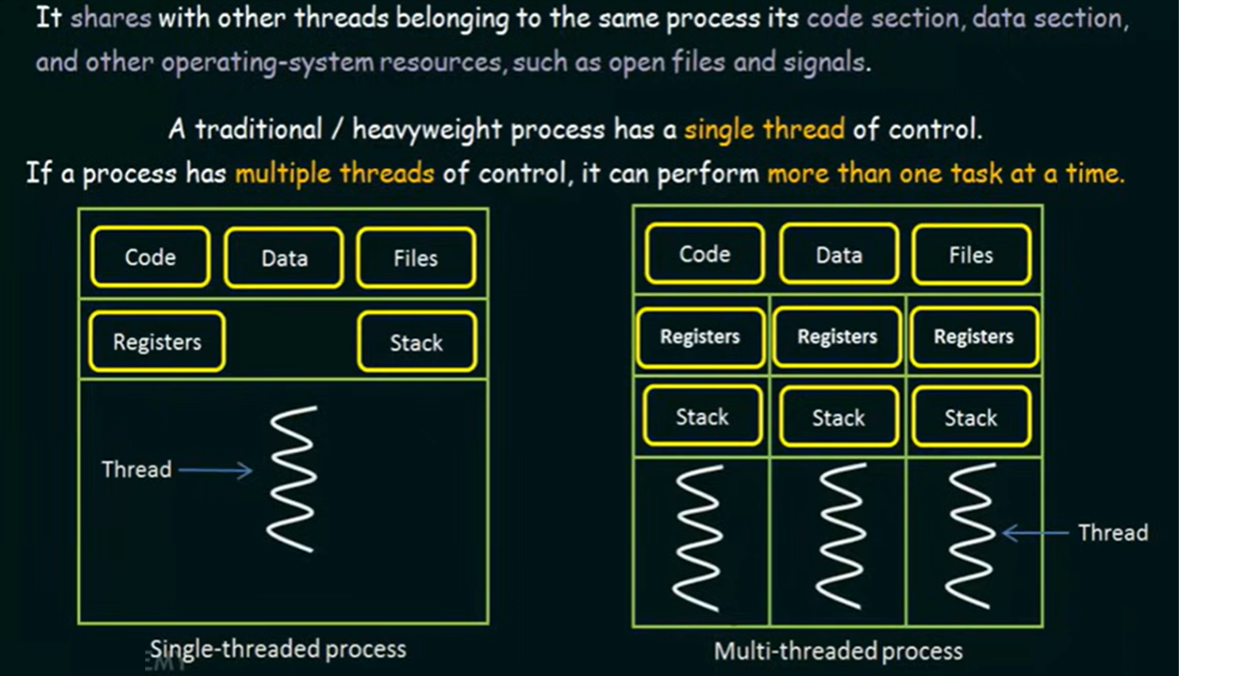

Slide 6
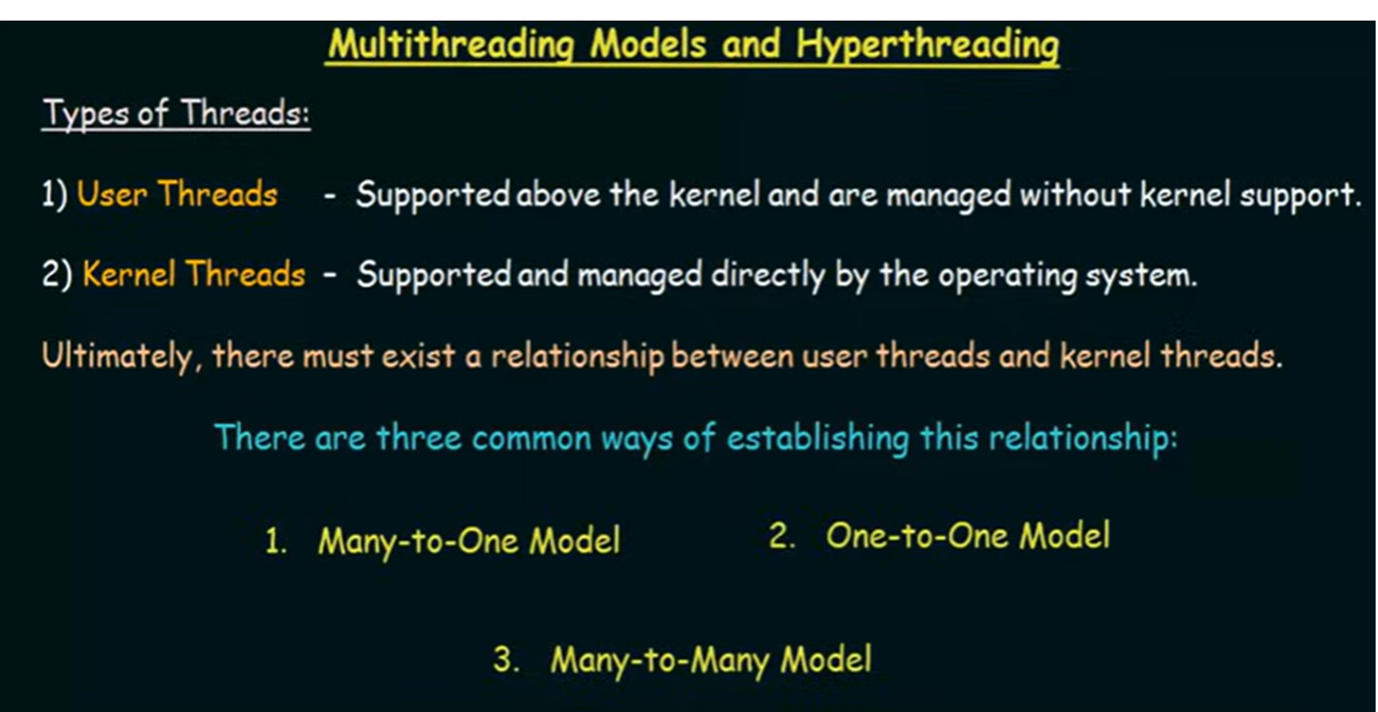

Slide 7
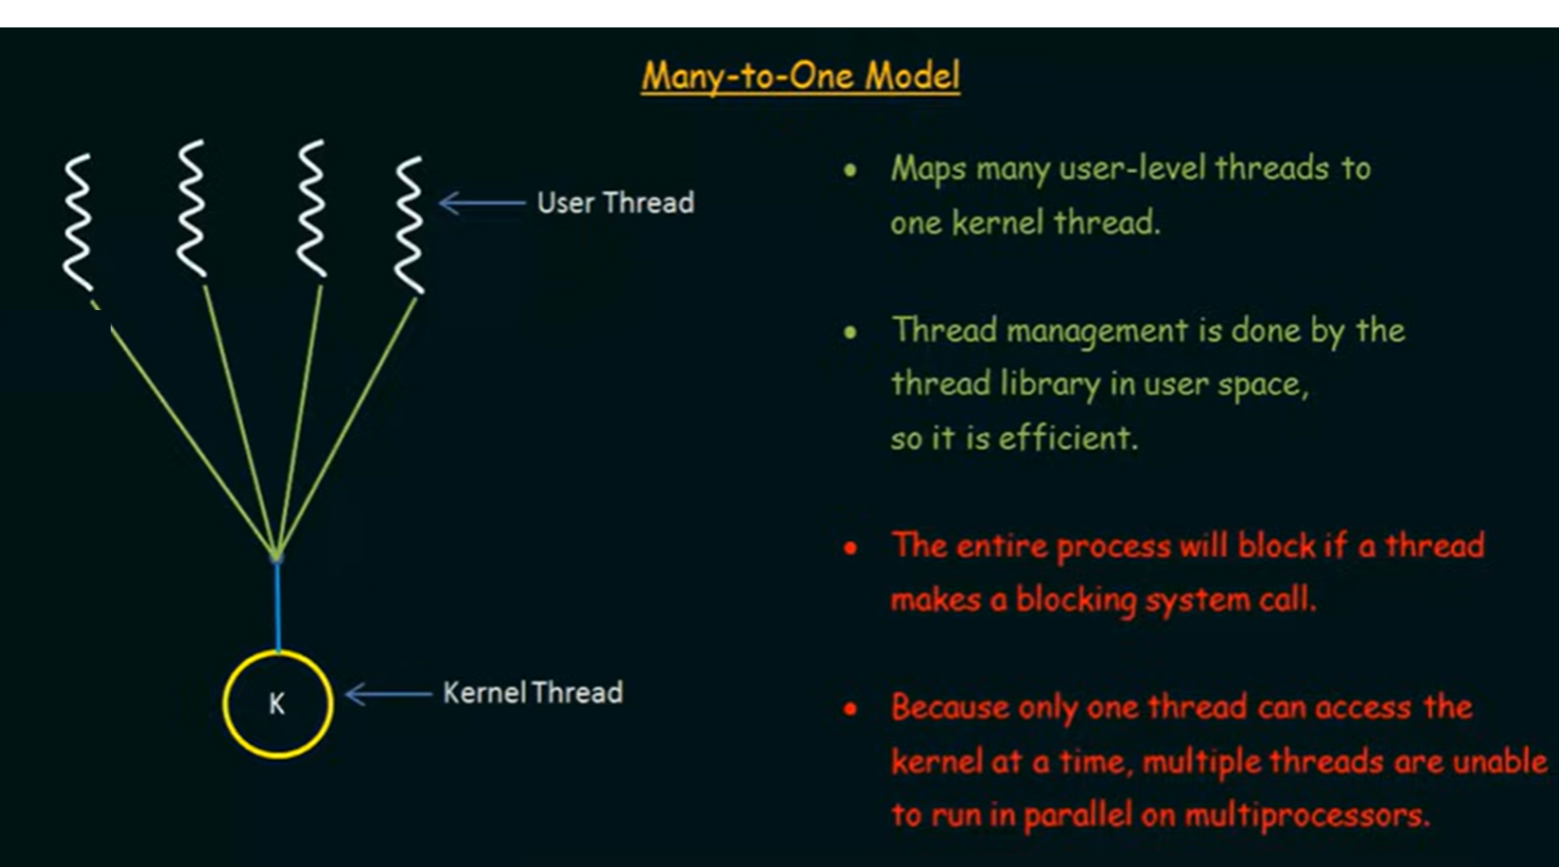

Slide 8
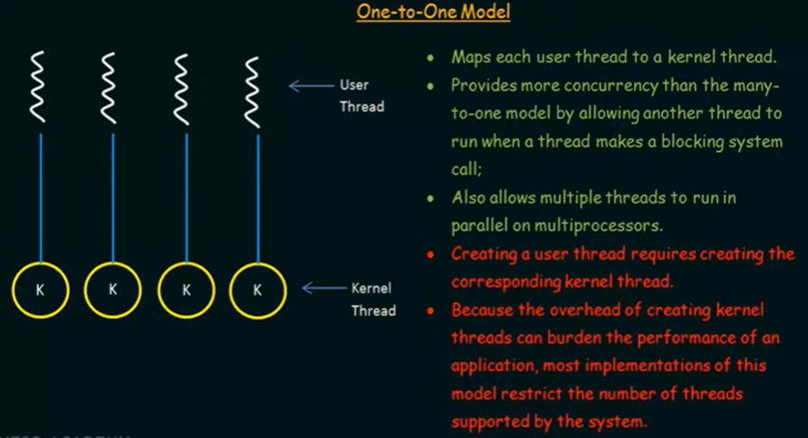

Slide 9
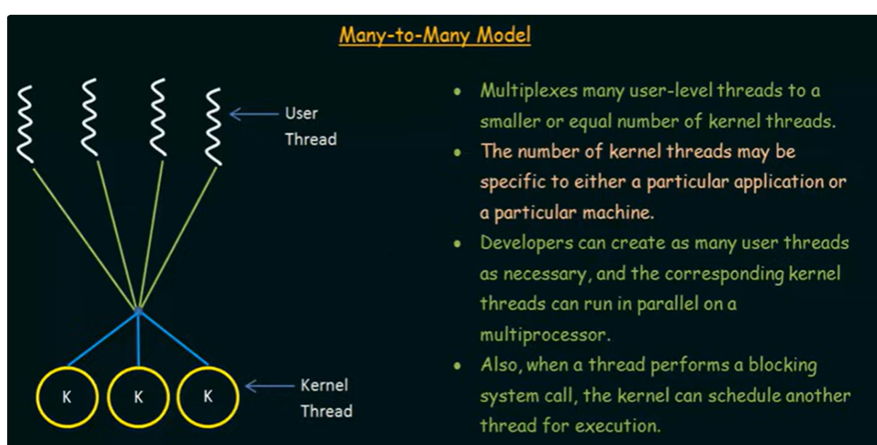

Slide 10


Slide 11
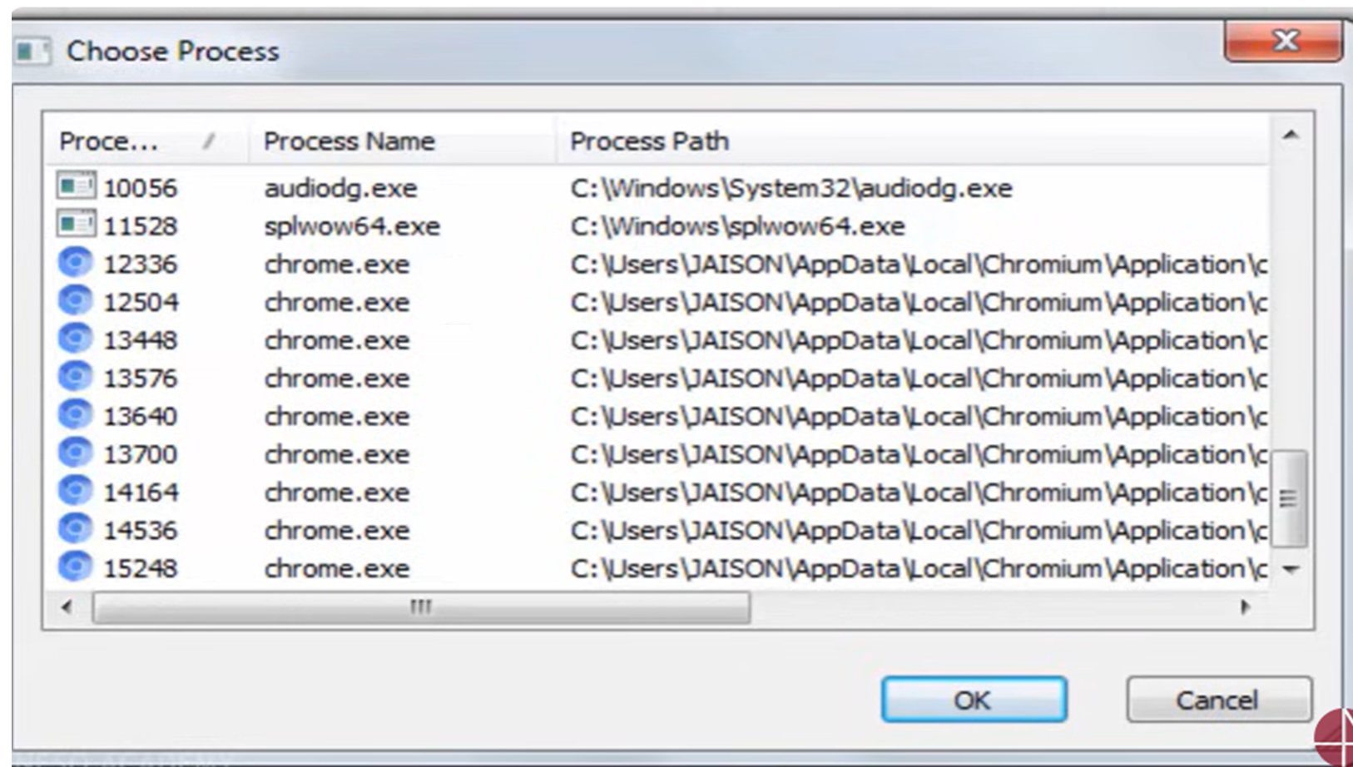

Slide 12
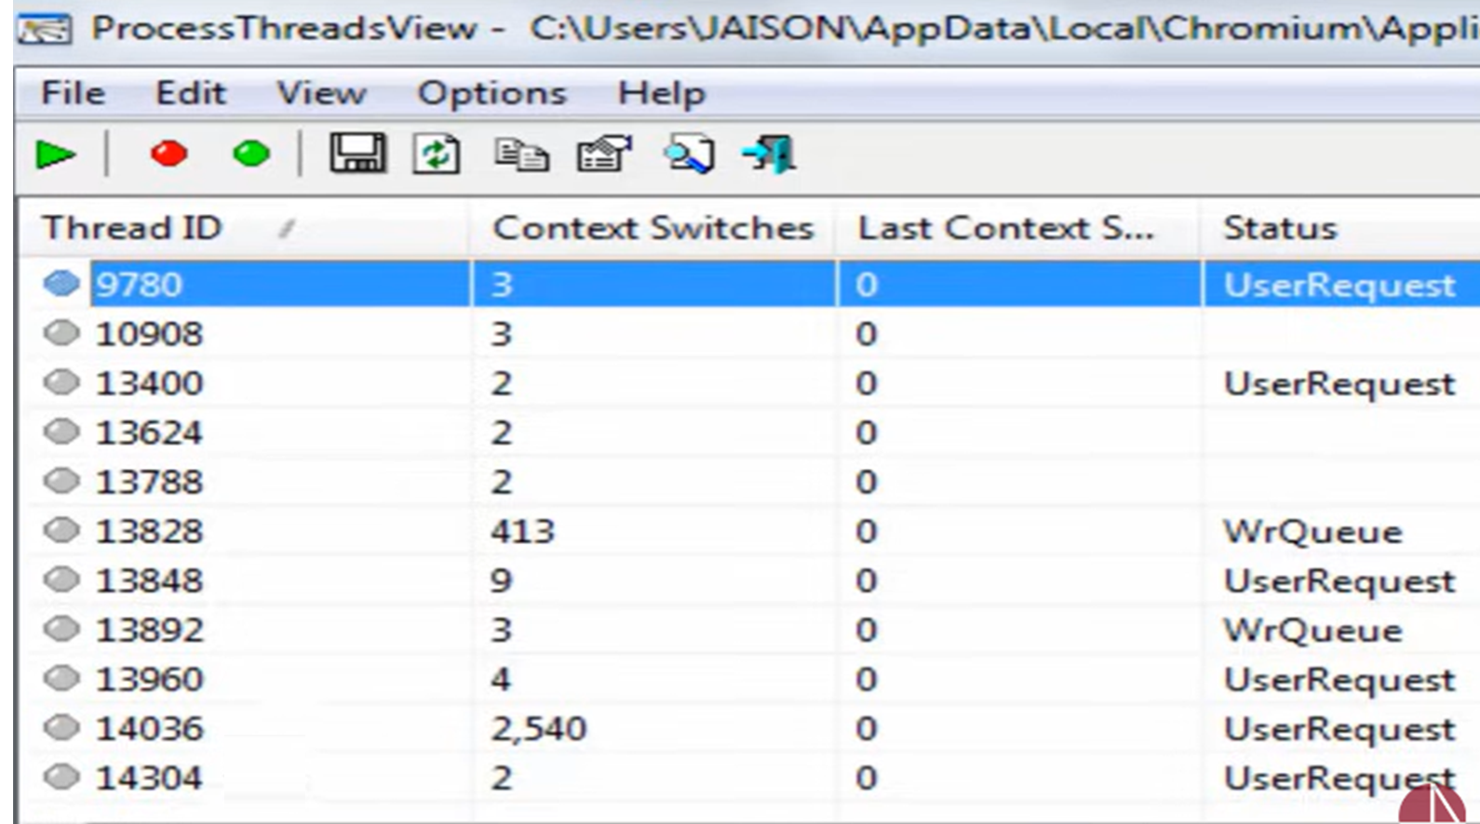

Slide 13
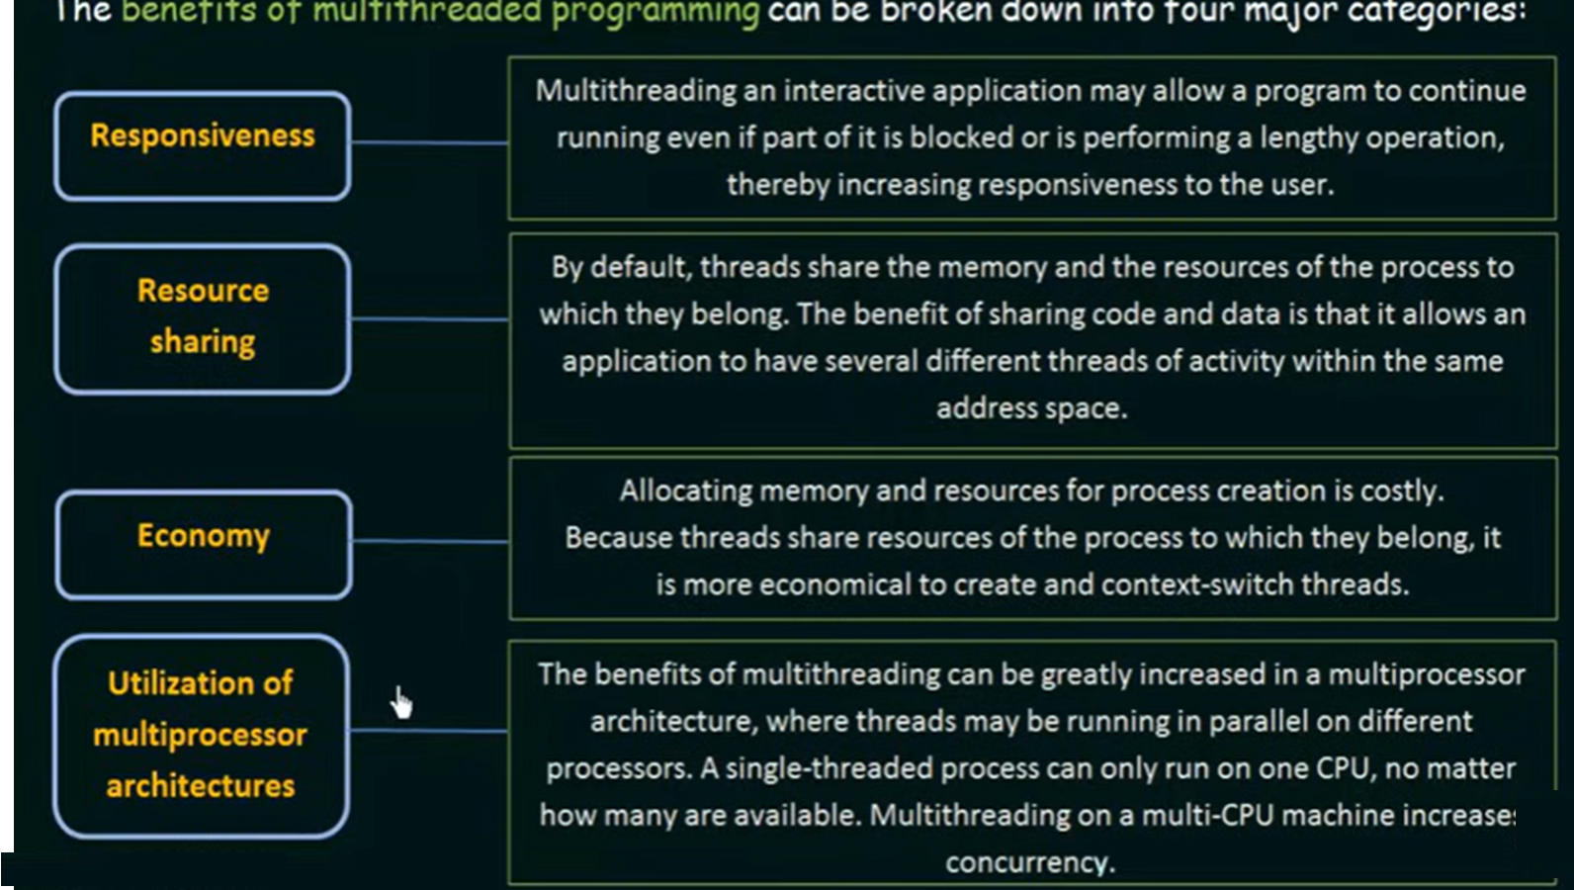

Slide 14
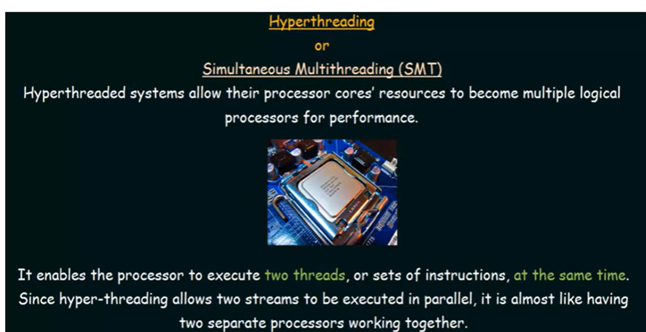

Slide 15
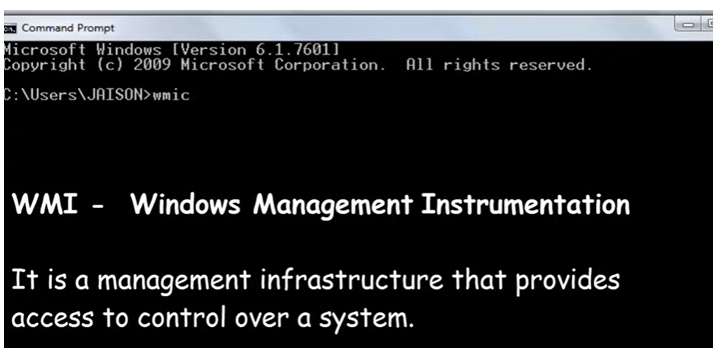

Slide 16
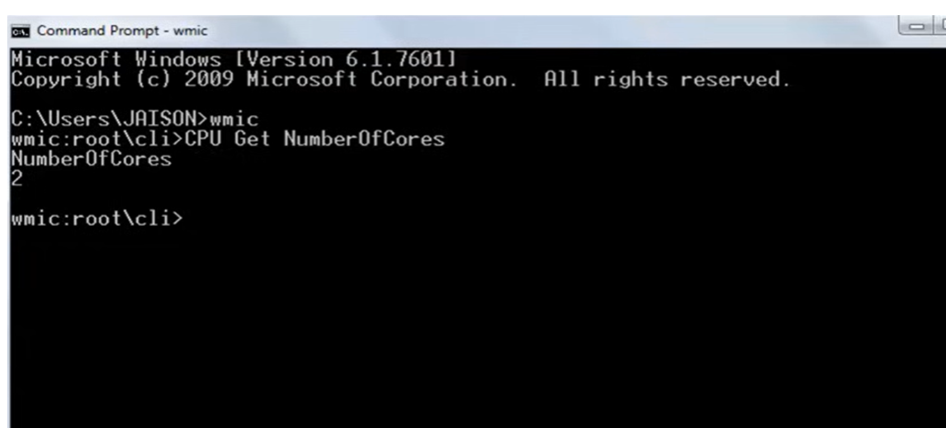

Slide 17
Thank You

